Slide 1
Automation in Postman
Automated tests in Postman
By Hoang.Vu

Slide 2
Agenda
 | JavaScript
 | Pre-request Script
 | Tests
 | Test runners
 | Q & A
1
2
3
4
5

Slide 3
JavaScript
01

Slide 4
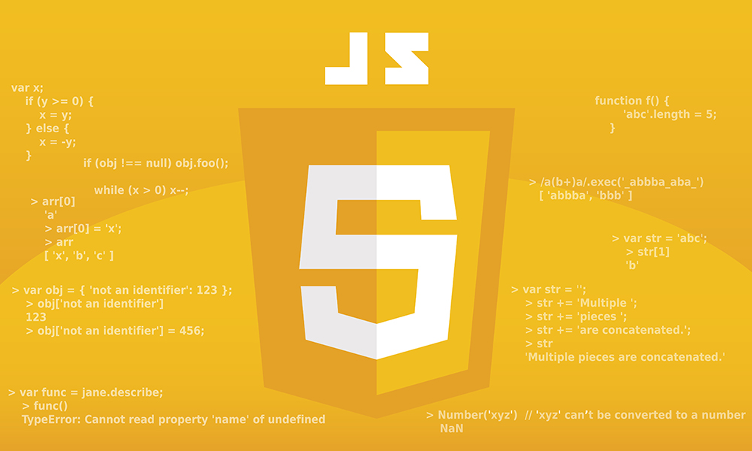
JavaScript
Javascript is interpreted language.
Usually using in web development with html/css/javascript.

Slide 5
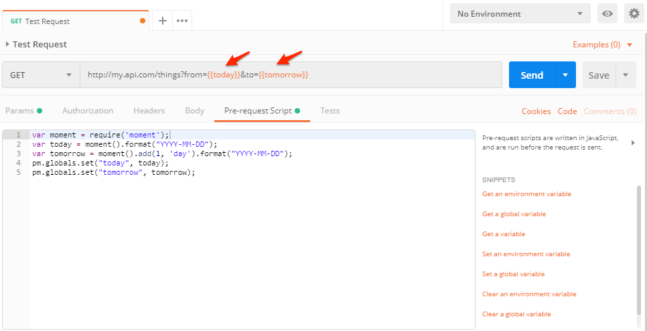
Pre-request Script
It run before executing main request.
Use this to prepare all required data before running..

Slide 6
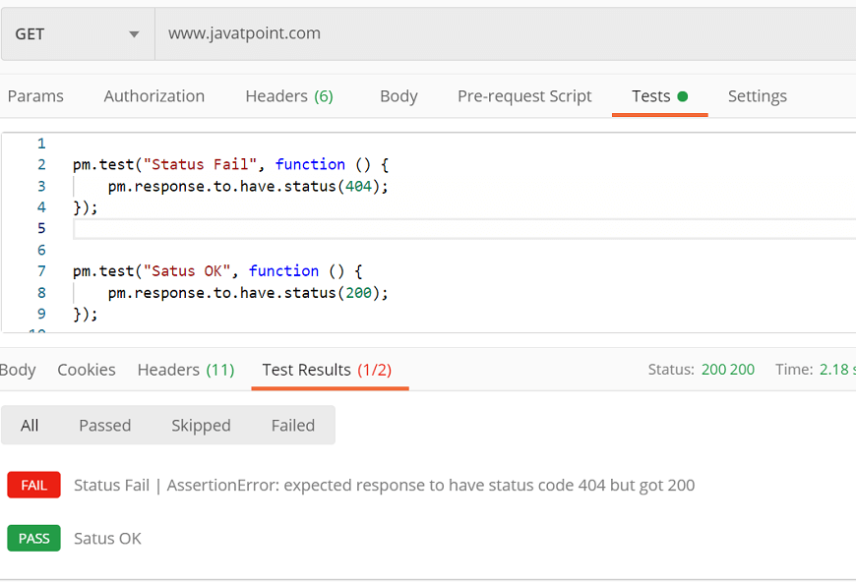
Tests
Using to write testcases.
Write assertion to validate response.

Slide 7
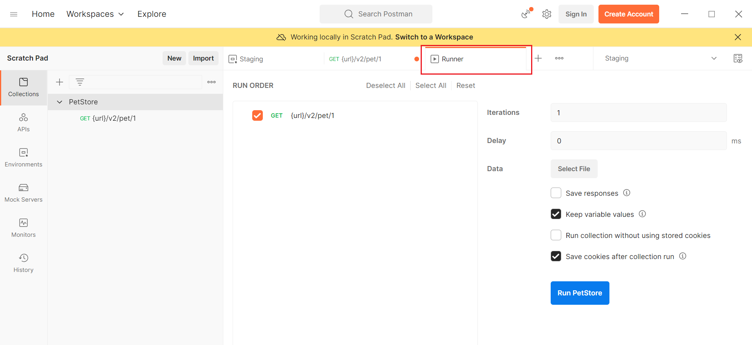
Runners

Slide 8

Q&A

